Slide 1
Refrigeration

Slide 2
Refrigeration:

Slide 3
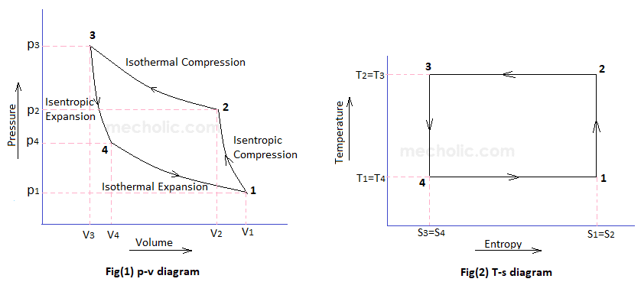
Reversed Carnot Cycle: (Working Fluid - Air)

Slide 4
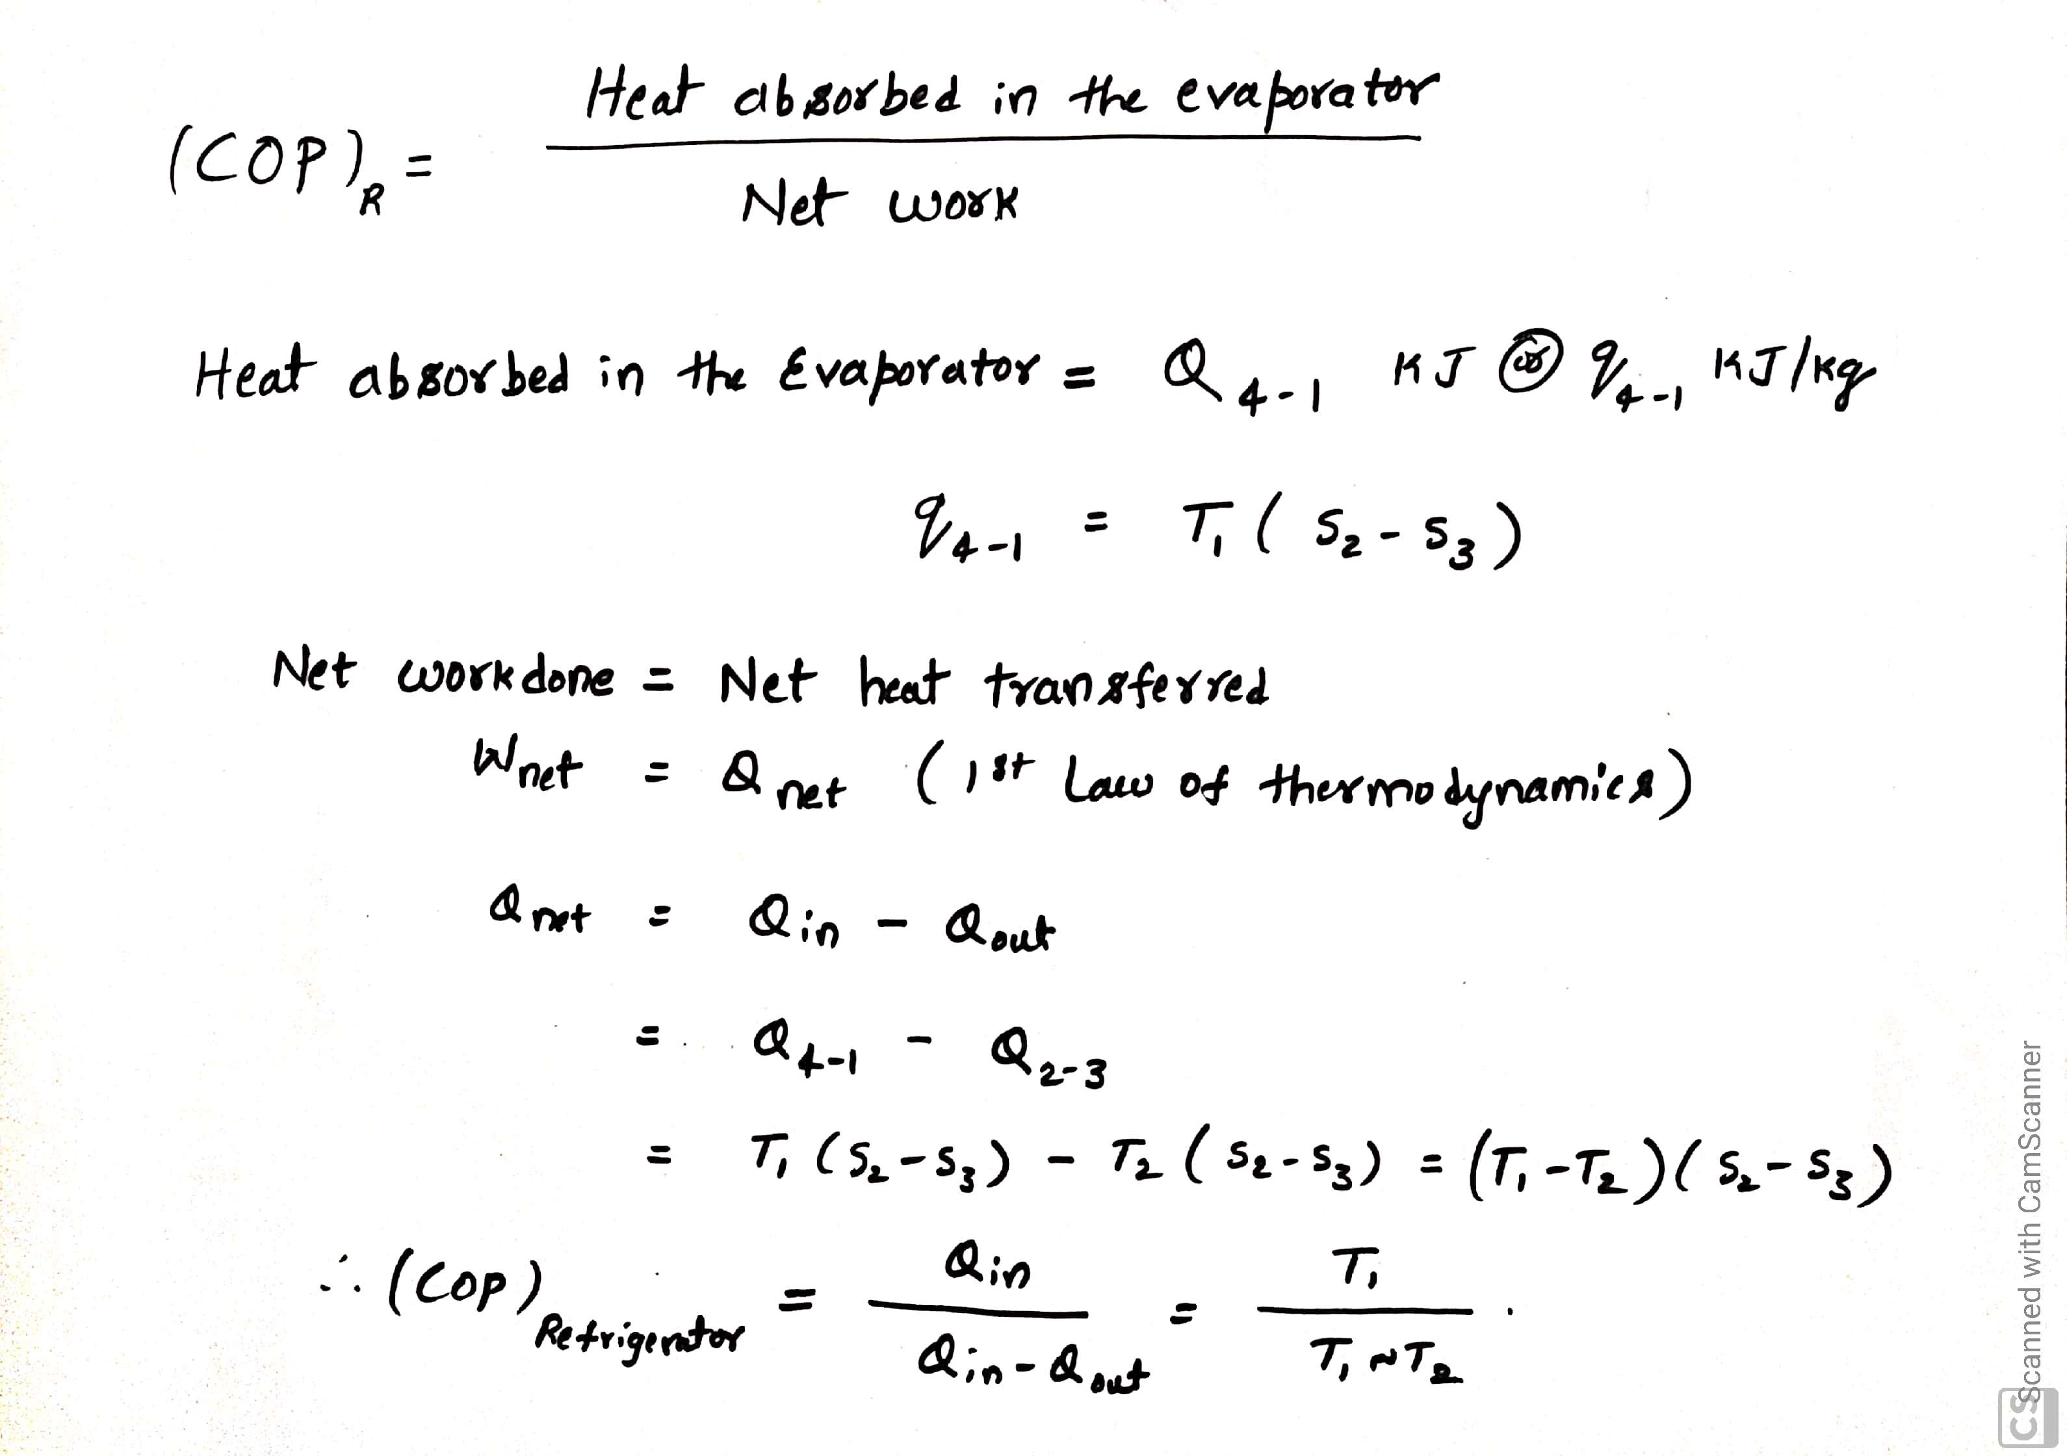
COP of Carnot cycle with Air as working fluid:

Slide 5
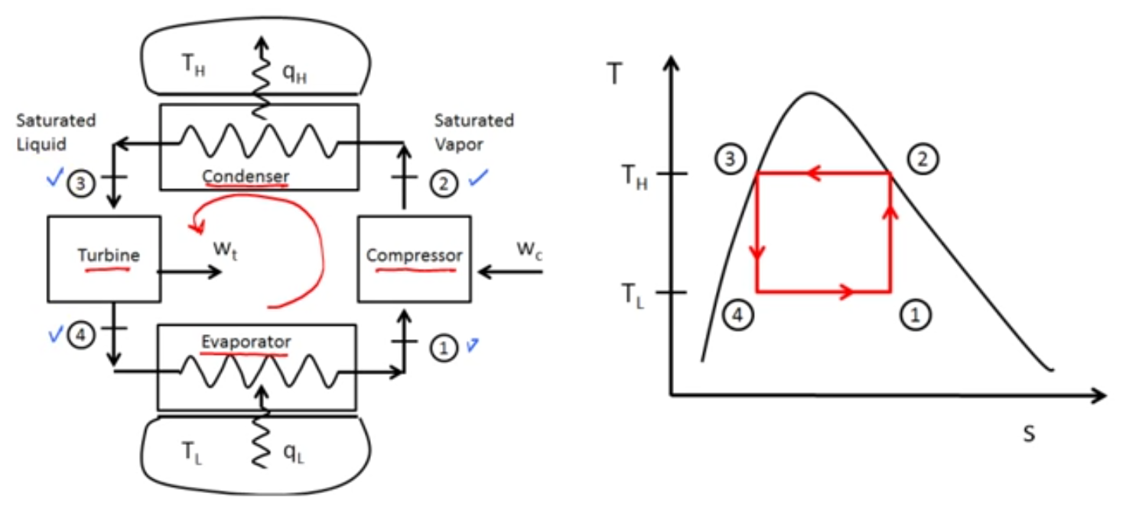
Reversed Carnot Cycle: (Working Fluid – Phase Change material)

Slide 6
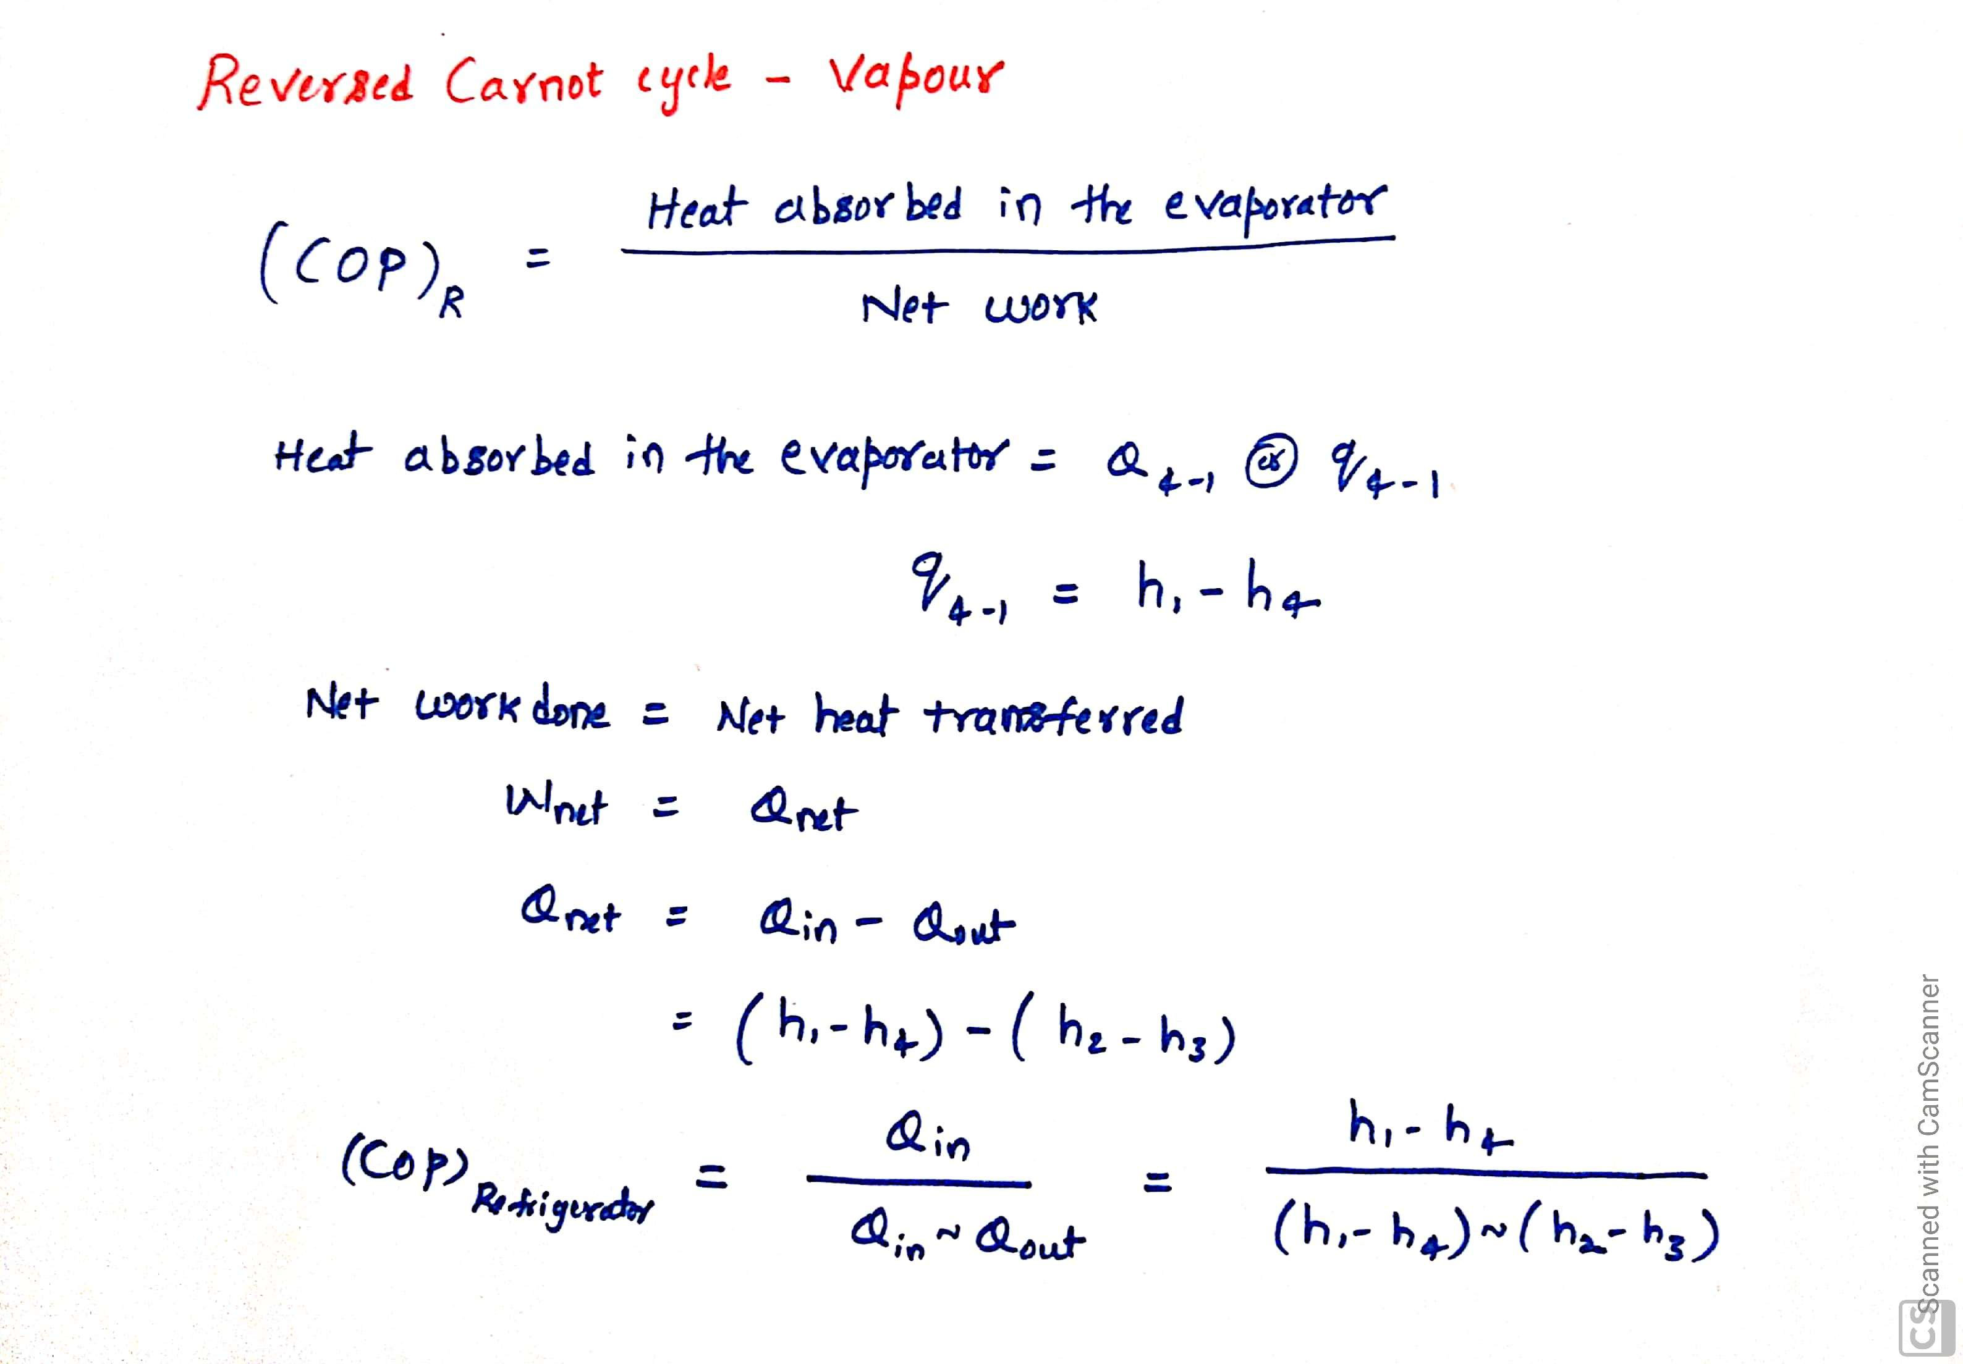
COP of Carnot cycle with any phase change material as working fluid:

Slide 7
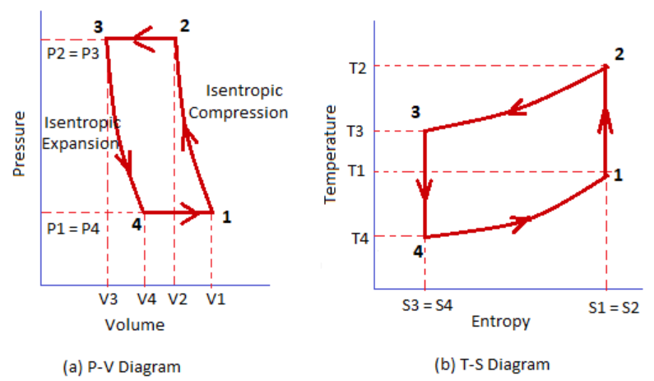
Bell Coleman Cycle (or) Reversed Brayton Cycle (or) Joule Cycle:

Slide 8
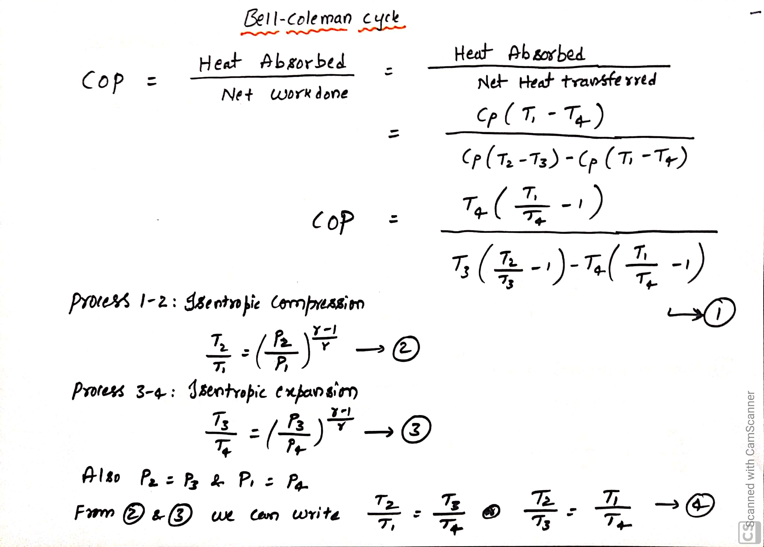

Slide 9
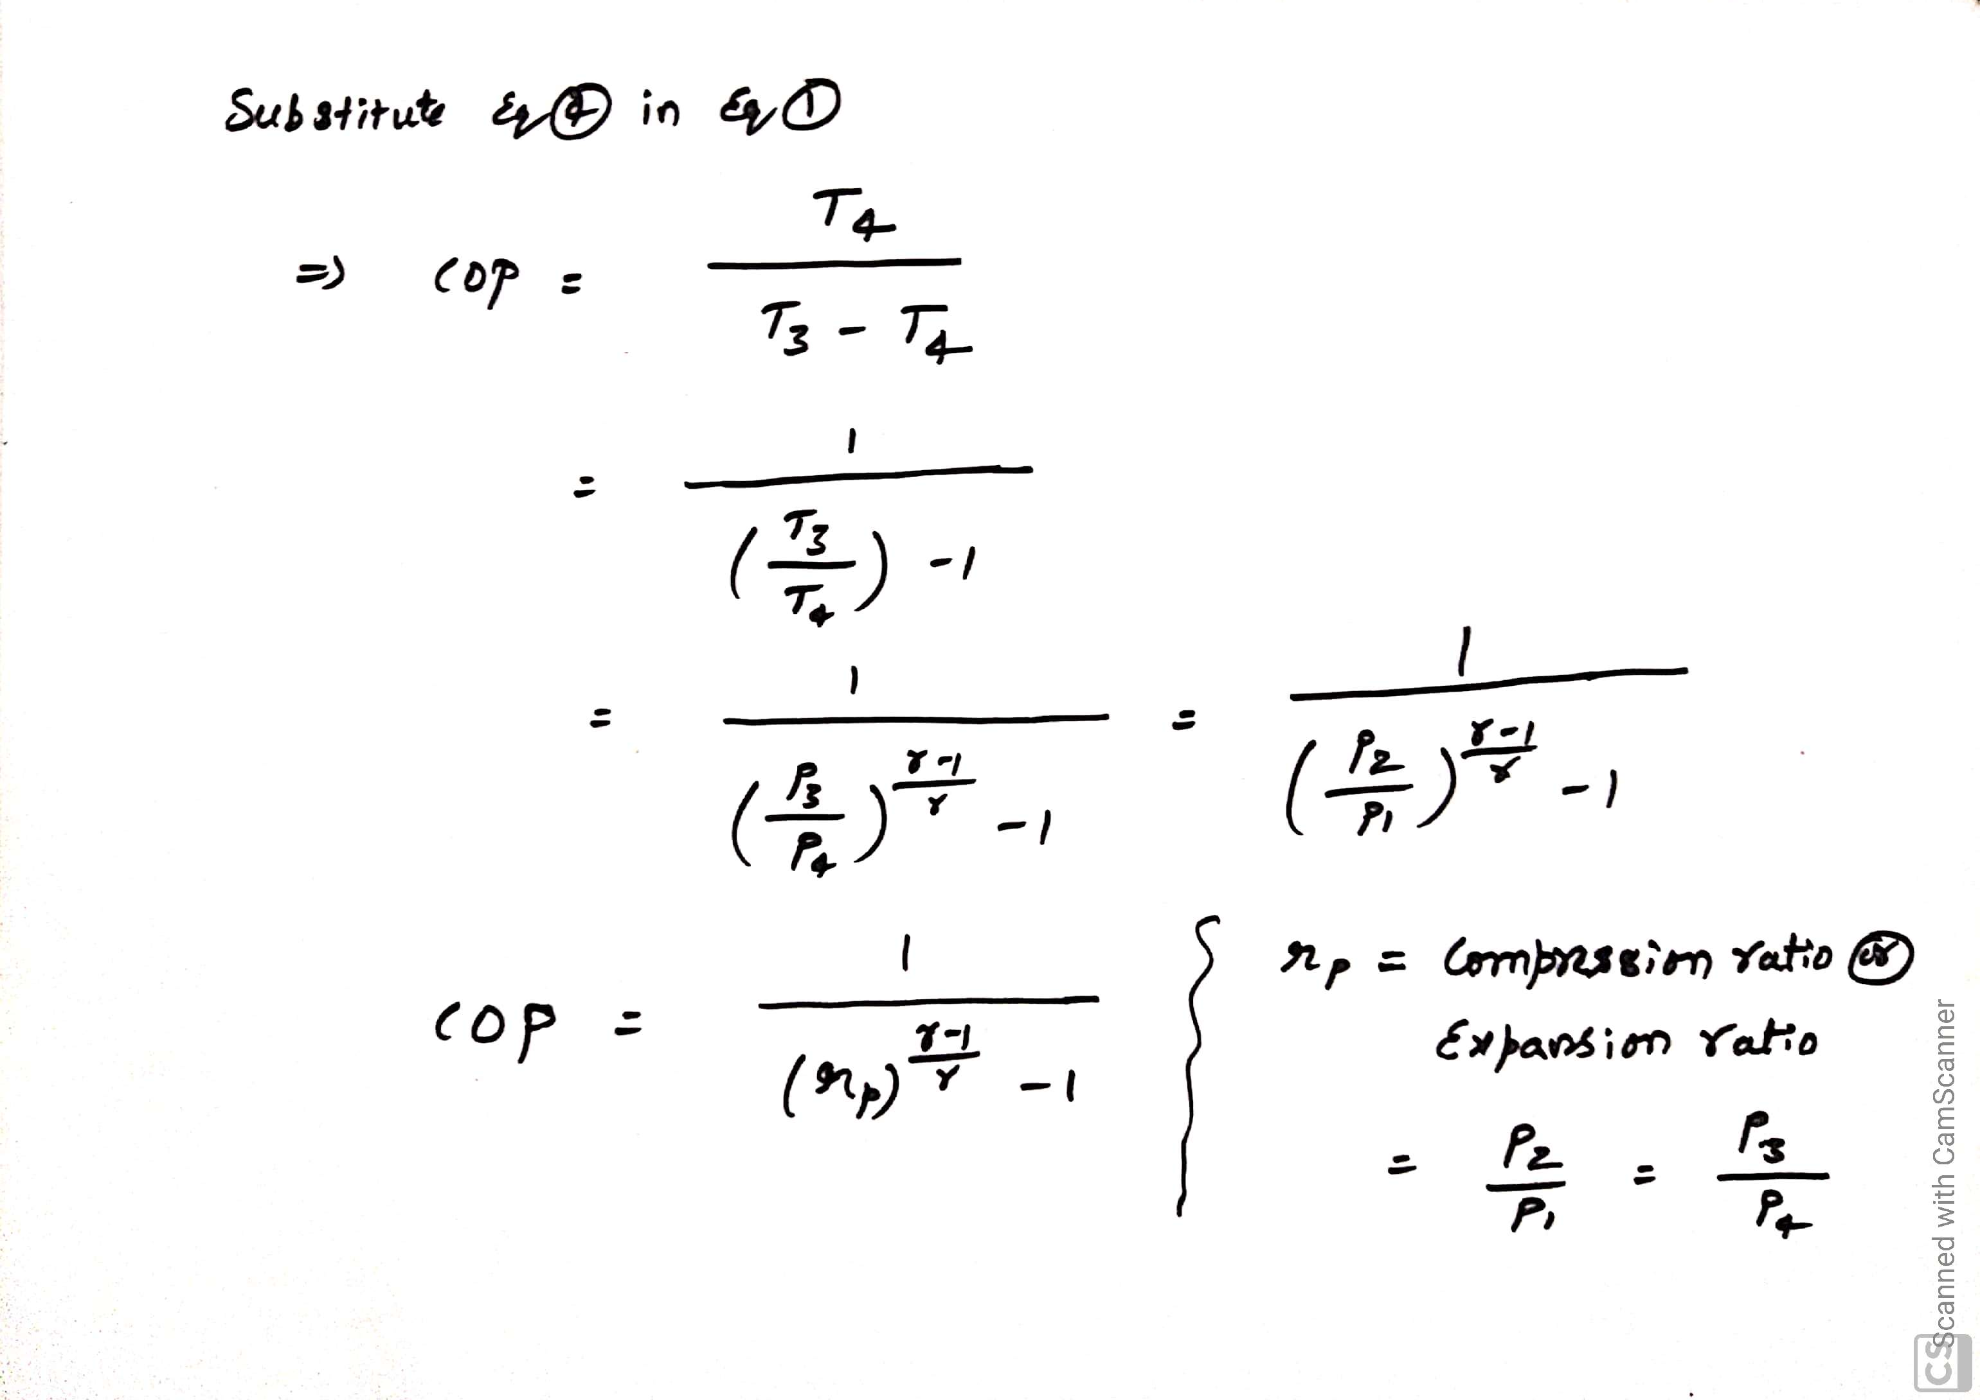

Slide 10
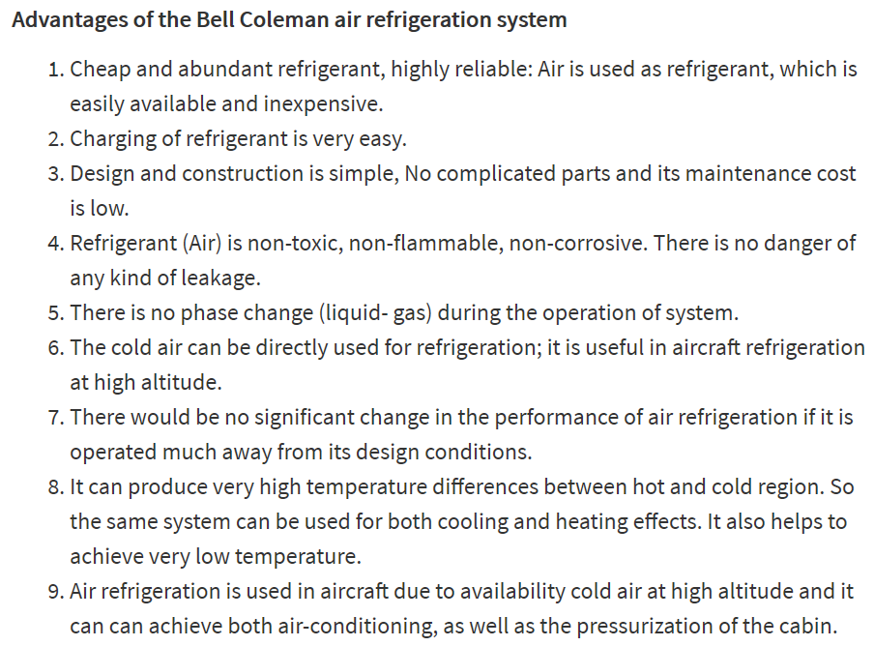

Slide 11
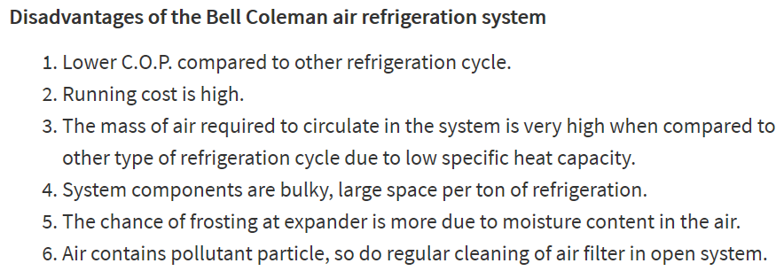

Slide 12
Vapor Compression Refrigeration System: (VCRs)

Slide 13
Vapor Compression Refrigeration System: (VCRs)

Slide 14
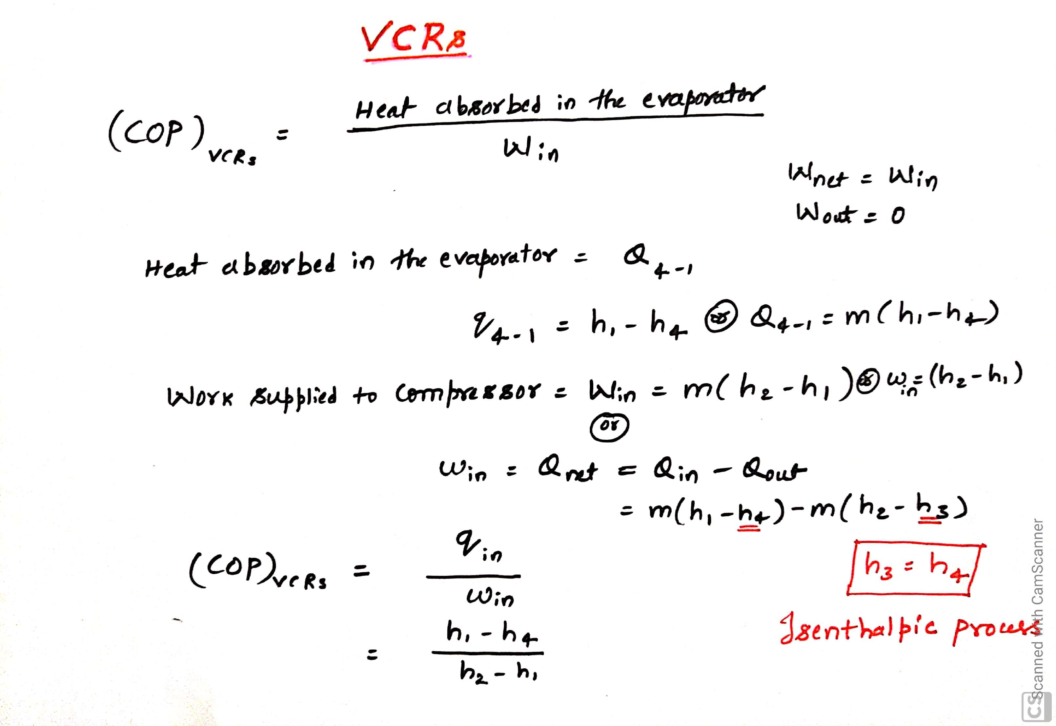
COP of VCRs:

Slide 15
Actual VCRs:

Slide 17
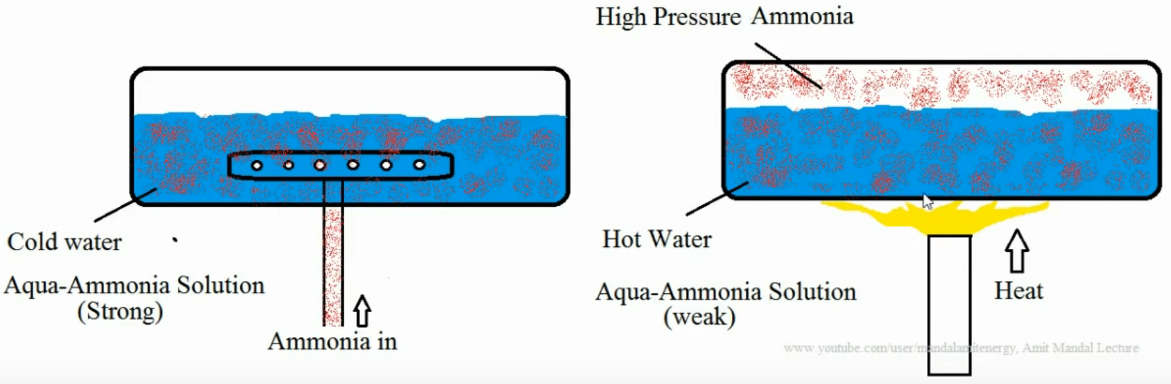
Vapor Absorption:

Slide 18
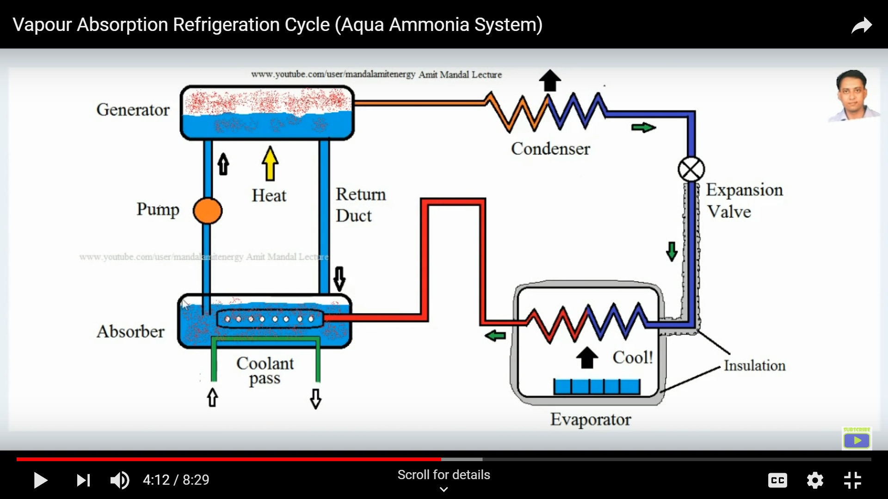
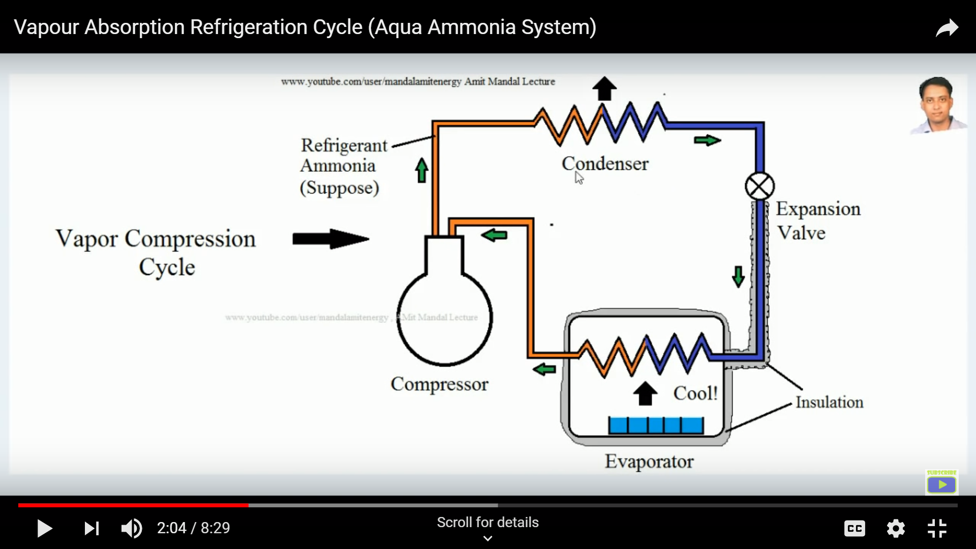
Vapor Absorption Refrigeration System: (VARs)
Vapor Compression Refrigeration

Slide 19
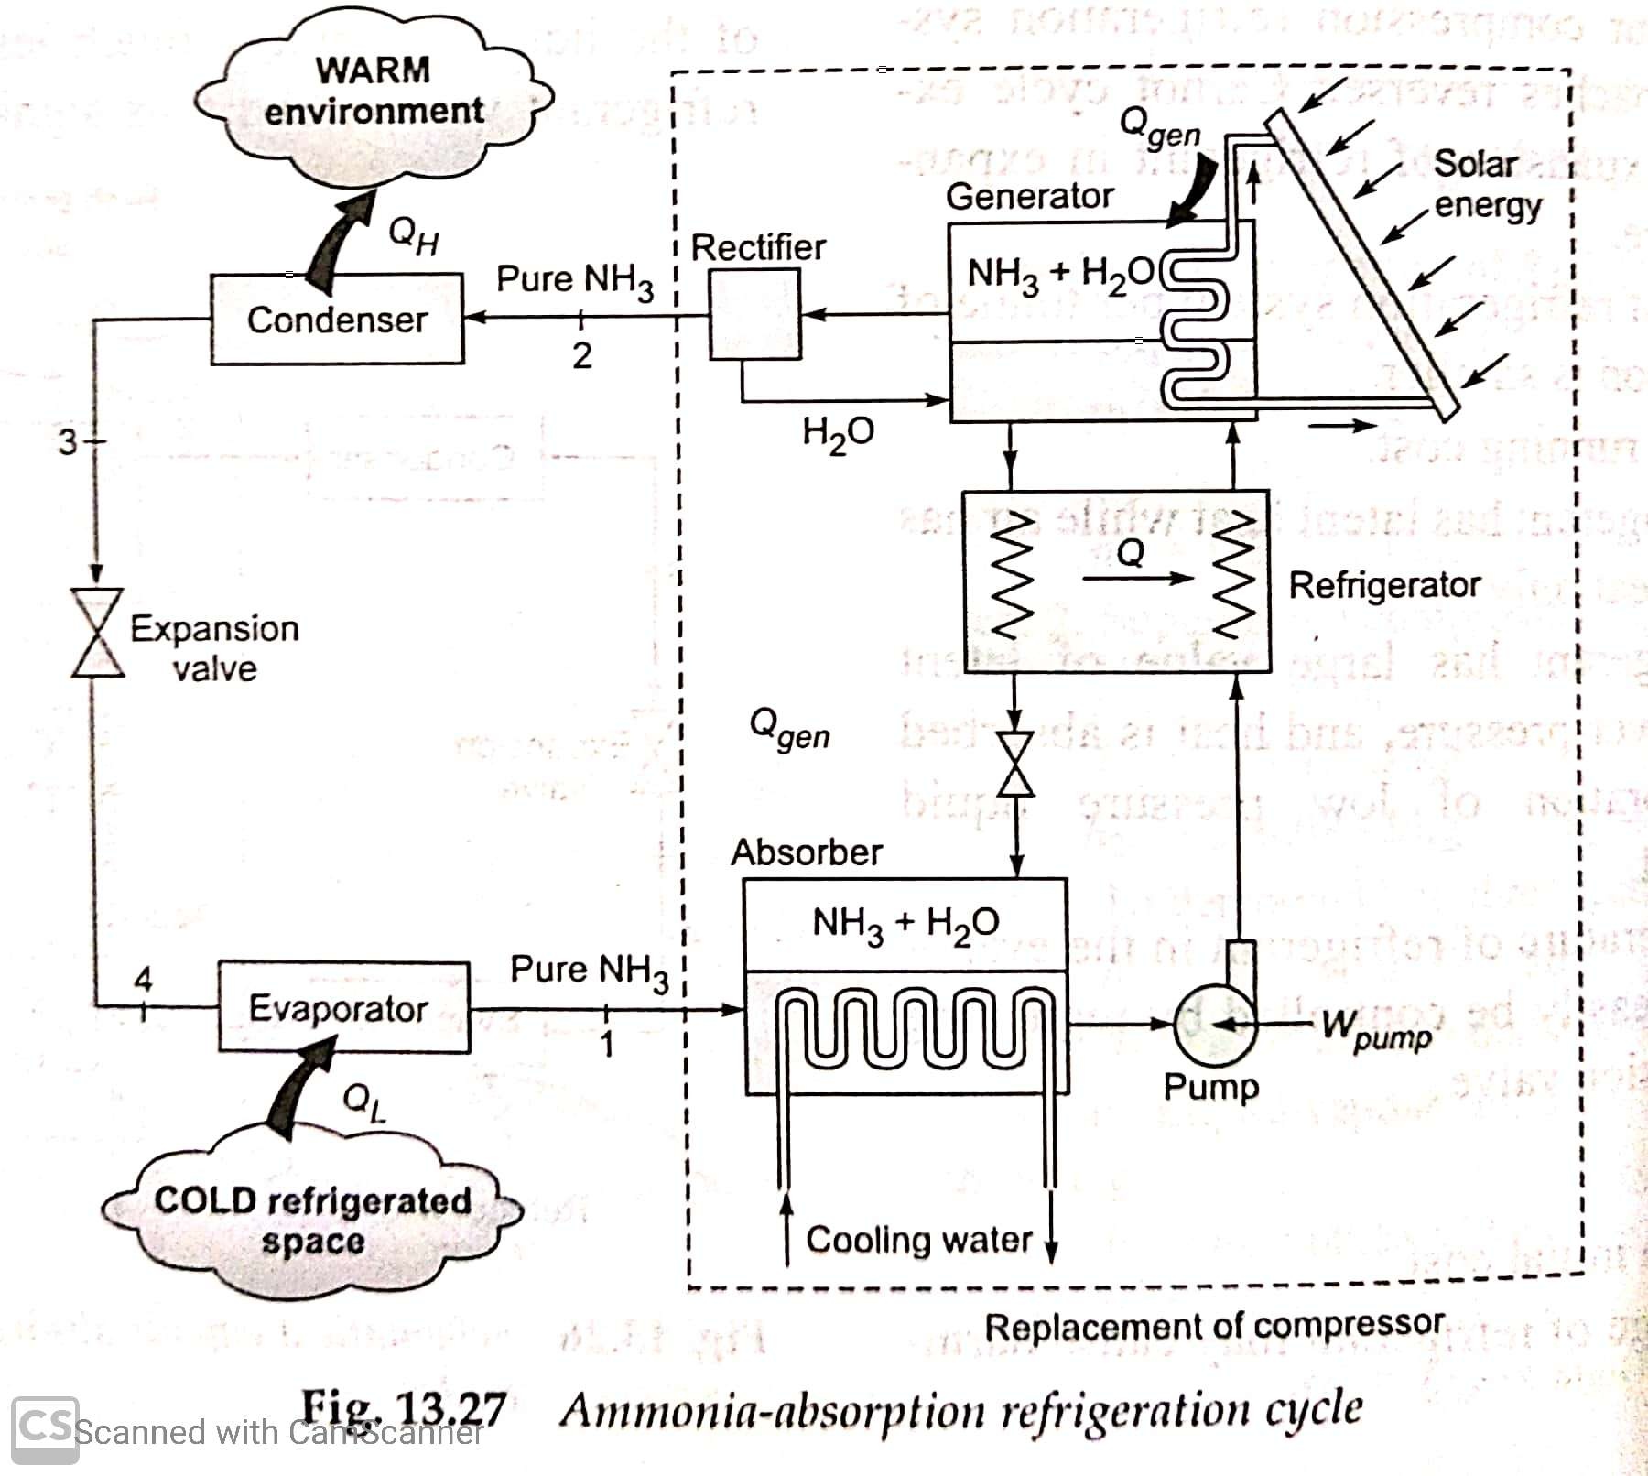
Ammonia-Water VARs:

